Slide 1

SIMPLIFICATION OF BOOLEAN FUNCTIONS
Moisil’s Method
Truță David

Slide 2
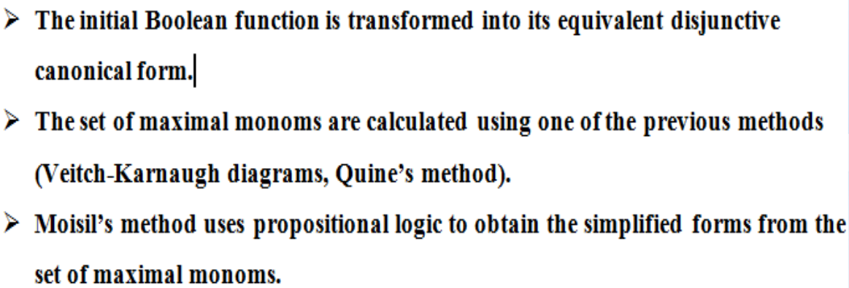
Moisil’s simplification method

Slide 3




Exercise 8.7
We find support of f, then we find the set of maximal monoms using Quine’s method.
f(x, y, z) = m1 ν m2 ν m4 ν m6
f is given in DCF (disjunctive canonical form)
Sf = {(0,0,1), (0,1,0), (1,0,0), (1,1,0)} – support of f
Truth table of f:
x | y | z | f(x, y, z)
0 | 0 | 0 | 0
0 | 0 | 1 | 1
0 | 1 | 0 | 1
0 | 1 | 1 | 0
1 | 0 | 0 | 1
1 | 0 | 1 | 0
1 | 1 | 0 | 1
1 | 1 | 1 | 0
Group | x | y | z
I √ √ | 0 | 0 | 1
 | 0 | 1 | 0
 | 1 | 0 | 0
II √ | 1 | 1 | 0
III | - | 1 | 0
 | 1 | - | 0
M(f) = {max1, max2, max3}

Slide 4
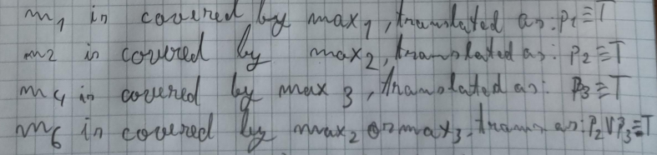
Because the simplified form of a function contains only the maximal monoms, we consider the following propositional sentences:
pi : “maxi = belongs to the simplified form of f”, i = 1,2,3,4
Each minterm of the function’s expression must be covered by a maximal monom in a simplified form, therefore according to the result of the factorization process we have the following true sentences:
All the minterms from the function’s expression must be covered by a minimum number of maximal monoms, with a minimum numbers of overlaps. This statement is modeled by the following propositional formula obtained as a conjunction of all the previous true sentences:

Slide 5
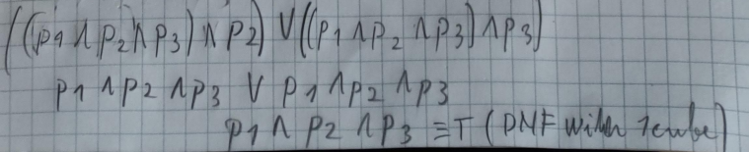

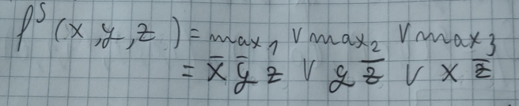
The CNF is transformed into DNF
A DNF is true if at least one of it’s cubes is true.
From DNF we consider the cubes with the minimum number of propositional variables and correspondingly we obtain the simplified forms of f.
Since our DNF has only one cube, we get a unique simplified form

